Slide 1
The Battle of Neighborhoods (Toronto)
IBM DatA SCIENCE PROFESSIONAL CERTIFICATE’s capstone project
Omar HOUSSEIN

Slide 2
Business problem
Which neighborhood(s) to choose when opening a new restaurant in Toronto?
Selection factors:
Neighborhood known for a specific type of cuisine (restaurant category)
Neighborhood’s real estate price
Neighborhood’s crimes rate
Interest: The study could interest entrepreneurs aiming to open a restaurant in Toronto

Slide 3
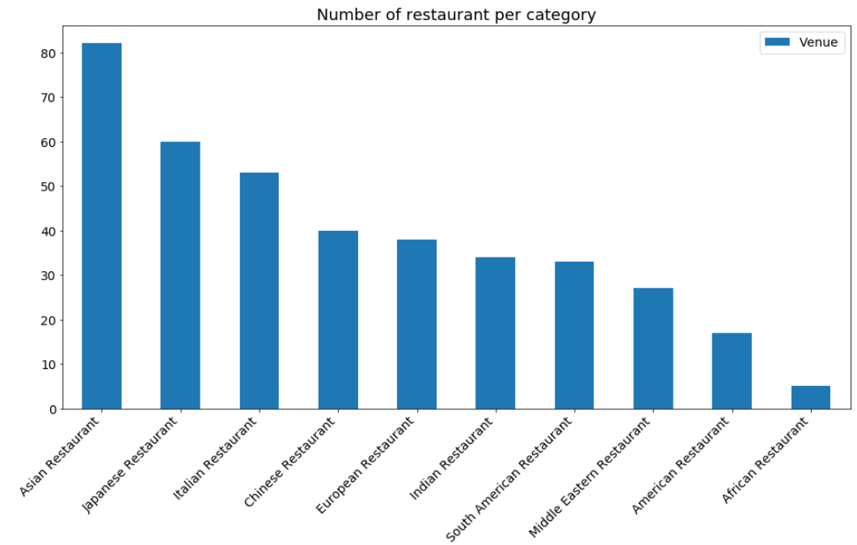
Restaurants distribution per category

Slide 4
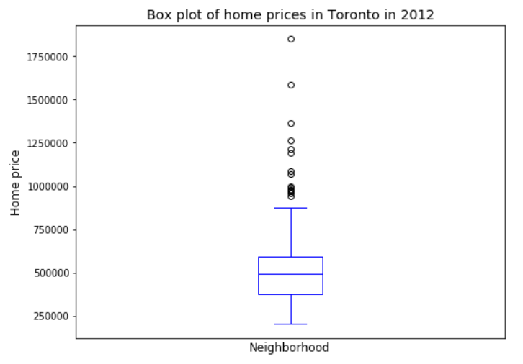
Home prices analysis
The median price of a house per neighborhood in Toronto in 2012, is about 500.000$.

Slide 5
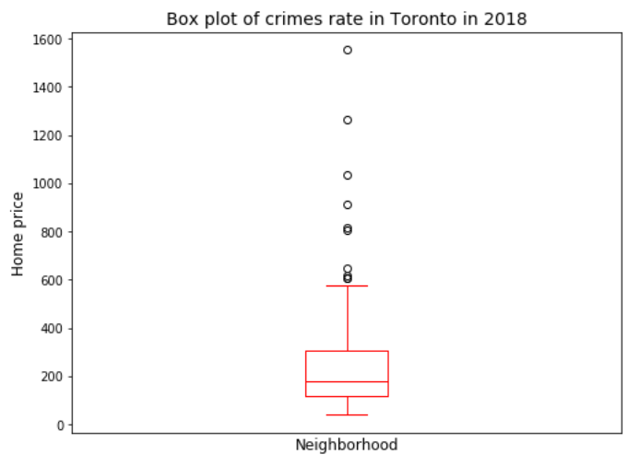
Home prices analysis
The median number of crimes per neighborhood in Toronto in 2018, is about 200.

Slide 6
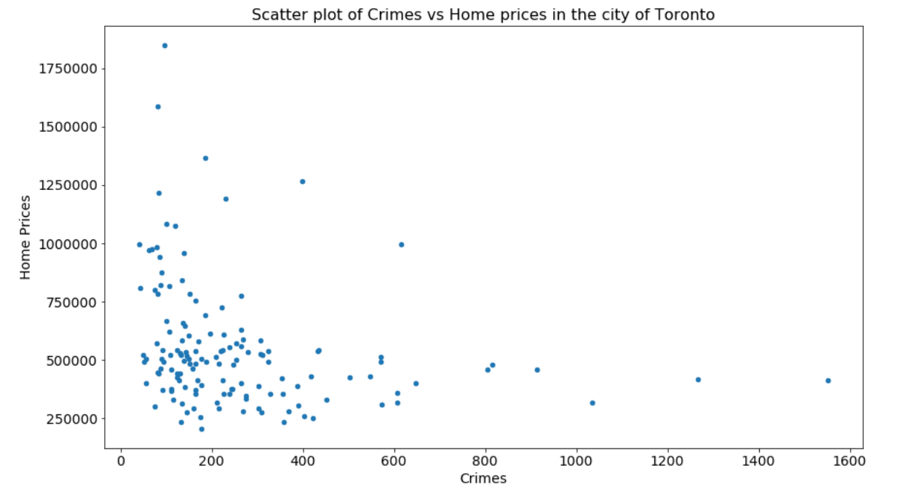
Relationship between home prices & crimes
The scatter plot doesn’t show any linear correlation between neighborhoods’ crimes rate and home prices

Slide 7
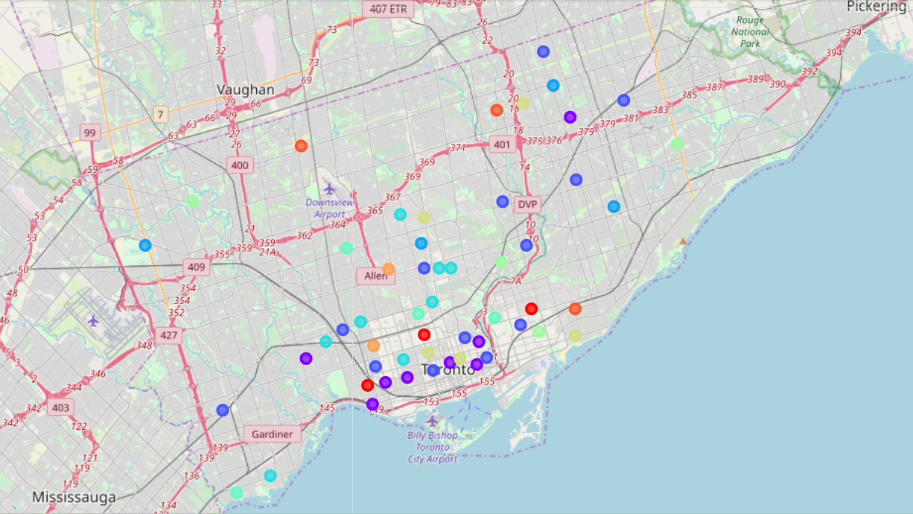
K-Means clusters on Toronto map

Slide 8
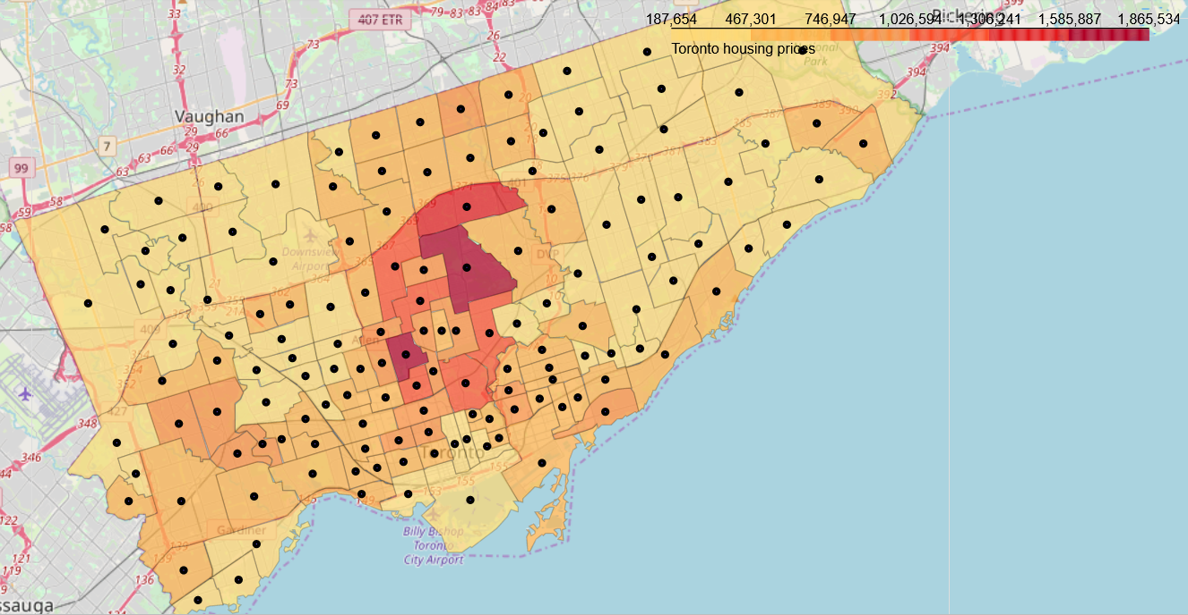
Home prices choropleth map

Slide 9
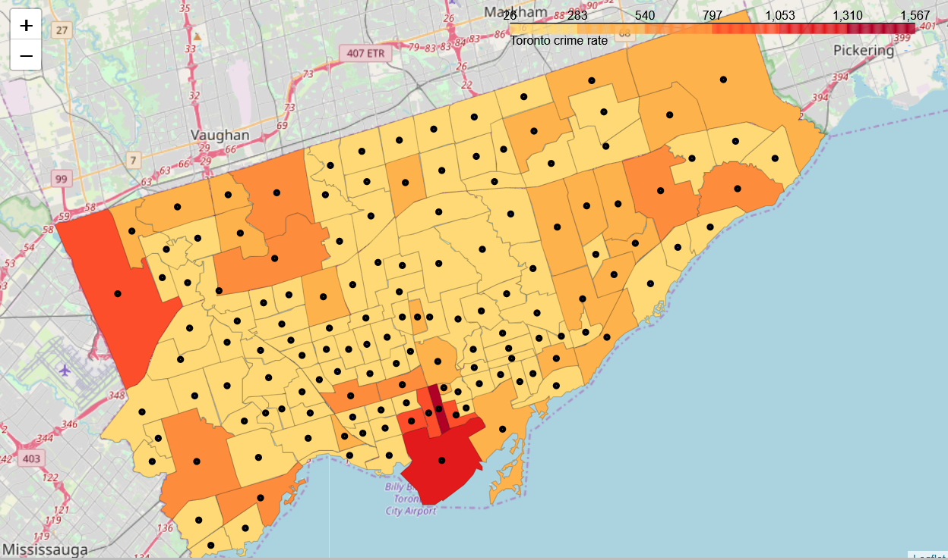
Crimes rate choropleth map

Slide 10
Conclusion and future directions
Data science was used to choose the best neighborhood(s) where to open a new restaurant in Toronto city
Machine learning algorithm used: K-Means clustering
Main data used:
Restaurant category, rating
Neighborhood home prices, crimes rate
Restaurants & neighborhoods’ geospatial data
Future direction: this study has its limits and should be completed by a marketing study

